Slide 1
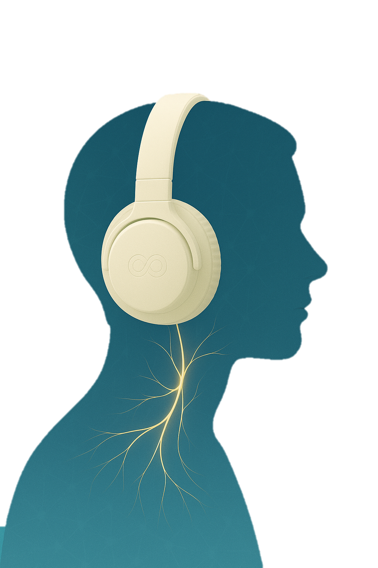
The Vagus Advantage
The New Science to Unlock Your Body’s Cognitive Control System
Dr. Ray Zhang, MD
and Richard Sprague

Slide 2
迷走神经优势
掌握神经刺激技术，提升现代健康
张大磊 与
Richard Sprague 著

Slide 3
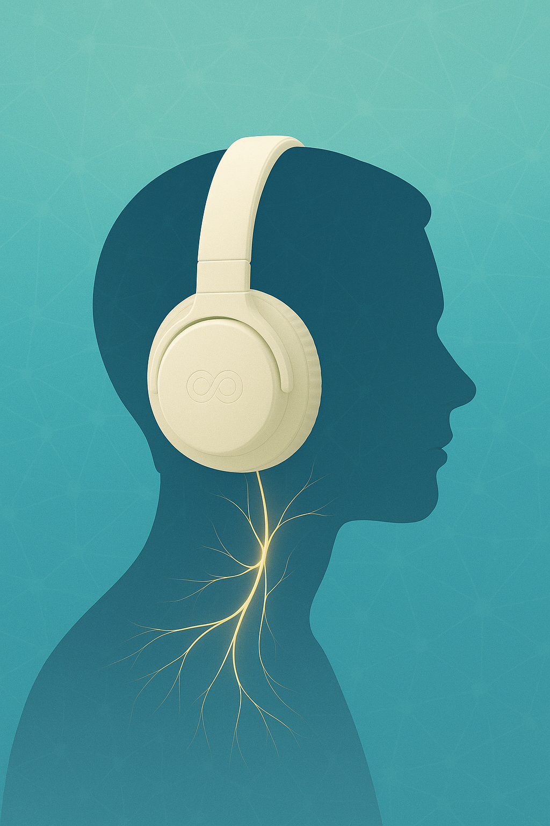
The Vagus Advantage
The Science of Red Light Therapy and Retinal Imaging
Dr. Ray Zhang, MD
and Richard Sprague

Slide 4
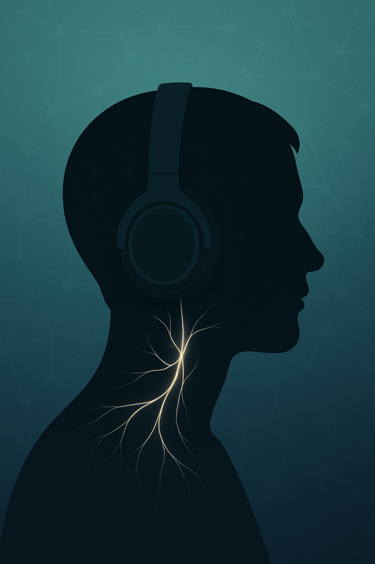
The Vagus Advantage
The Science of Red Light Therapy and Retinal Imaging
Dr. Ray Zhang, MD
and Richard Sprague

Slide 6
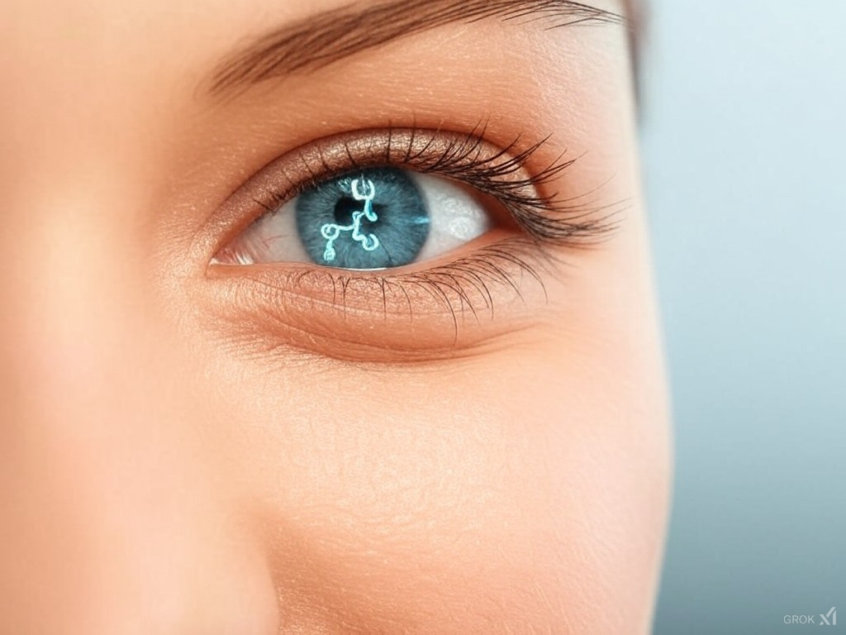
2D Opticare AI
The Red Light Miracle

